Slide 1
Python for Data Science
Course Introduction
© Explore Data Science Academy

Slide 2
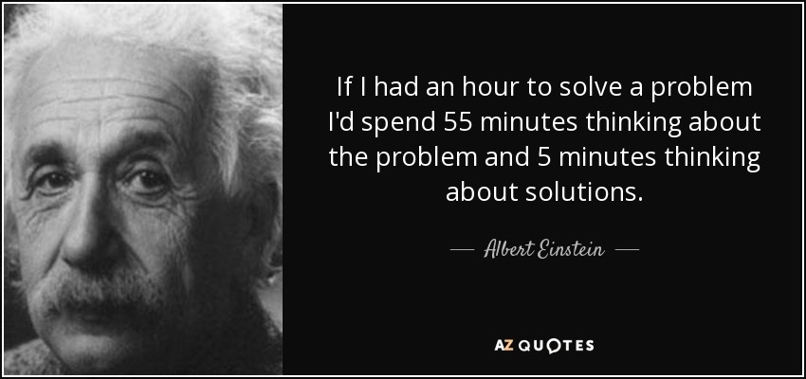
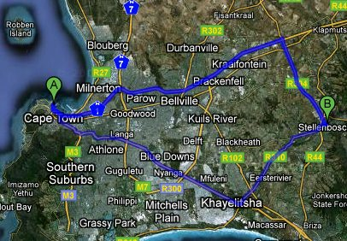
Using Programming to Solve Problems
Programming is problem solving
Implementing cool algorithms
A lot of problems have already been solved, we just need to know where to look
Implementation is key – waiting sucks!
The real skill is to be able to tweak them to use for a specific purpose.
Programming is a toolbox for solving problems
Programming is chunking a problem into smaller units which are easy to solve
Good programming allows us to solve a problem once, and apply that solution in solving other problems.

Slide 3
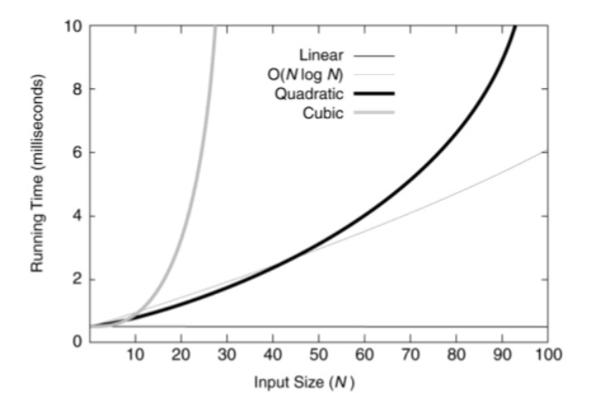
What is an Algorithm?
An ALGORITHM is a set of instructions to be followed to solve a problem
There are often many different algorithms which can be used to solve the same problem. Thus, it makes sense to develop techniques that allow us to:
compare different algorithms based on their “efficiency”
choose the most efficient algorithm for the problem
The efficiency of any algorithmic solution is a measure of the:
Time efficiency: the time it takes to execute
Space efficiency: space/memory it uses
Big O Notation represents the (order of the) maximum number of steps that an algorithm would require to find a solution to a problem, as a function of the input size.
Why do complexity analysis?
How do we measure efficiency?
What is
Big O Notation?
Constant Time
O(1)
Logarithmic Time
O(logN)
Linear Time
O(n)
Polynomial Time
O(n^{p})
Exponential Time
O(e^{N})

Slide 4




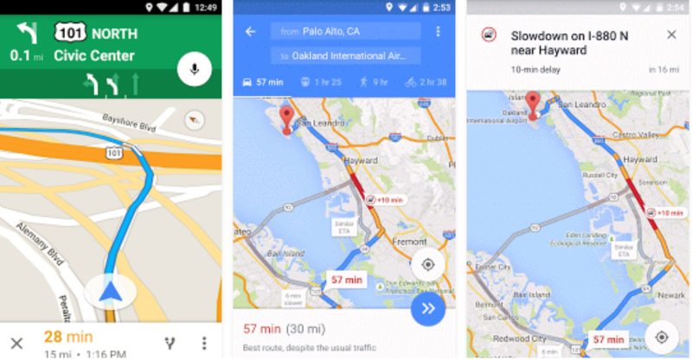
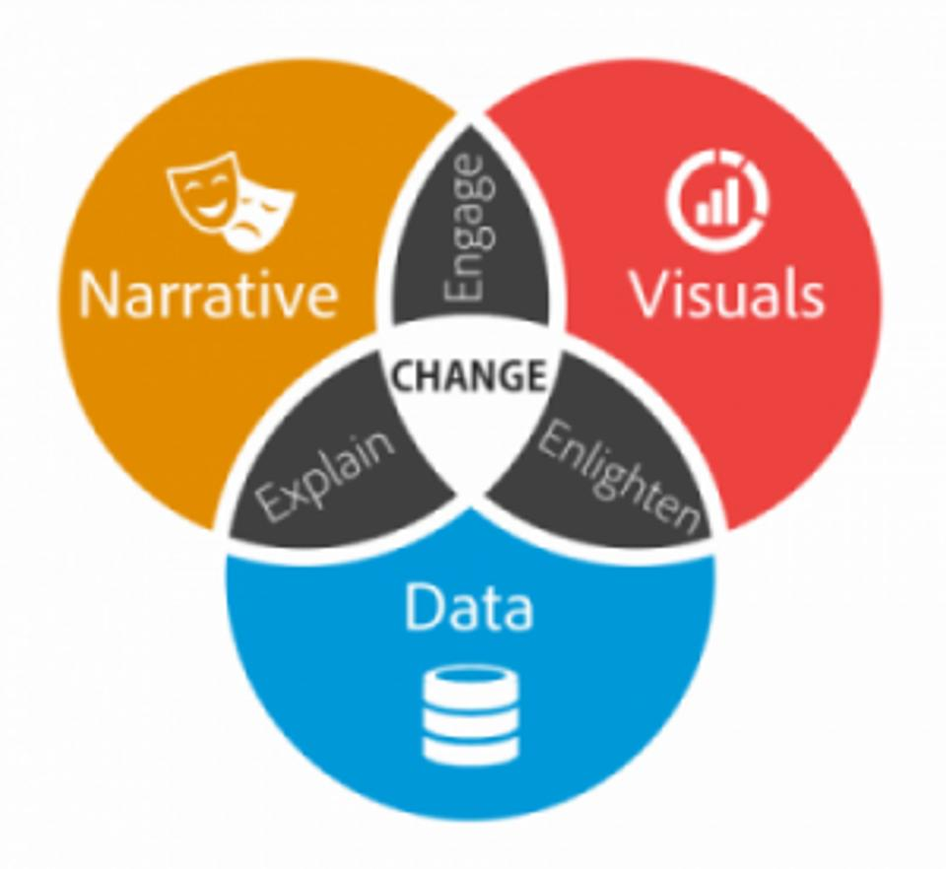
An Introduction to Python
Python is an interpreted, high-level and general-purpose programming language.
Python Programming
Applications of Python
Why Python?
Web applications
Finance and trading
Simple, versatile and easy to maintain
Runs on an interpreter system, faster execution of code
Popularity behind Python
More productive
Rich set of libraries and frameworks
Large community
Mapping and geography
Data science
Python IDE’s
PyCharm
Spyder
IDLE

Slide 5
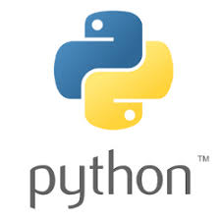


All you need to do data science in Python…
Python is a programming language that lets you work quickly and integrate systems more effectively.
We will be using Python 3+ for the rest of this course.
Anaconda is the world’s most popular Python data science platform.
Conda is a package manager to make sure all dependencies are managed so that everything works!
Project Jupyter exists to develop open-source software, open-standards, and services for interactive computing across dozens of programming languages

Slide 6

Course Components: Basic building blocks of Python
In this course, we will be covering the basic building blocks of Python for data science that will set us on a smooth trajectory into data science. Below are some of the concepts we will cover:
What will we cover?
Purpose in Python
Basic functions
Set of instructions that are executed when called
PEP8 coding style
Write clean and efficient code
Primitive data structures
Organize and store data that is easily accessible
Modules and Packages
Allows logical organization of code
Recursive functions
Reduces complexity of a task
Python scripting
Compile and execute Python code

Slide 7

Course Components: Data wrangling with Python
We will explore Python’s built-in features that can be integrated for data wrangling.
Data wrangling with Pandas
DataFrames
Merging data
Filtering data
DataFrame creation
Data manipulation
Aggregation
Data transformation
Data wrangling with Numpy
Dropping missing values
Grouping data
Multi-dimensional arrays and matrices
Exporting data
Perform mathematical operation on entire dataset.

Slide 8


Course Components: Statistical analysis with Python
We will also be exploring how to integrate the use of Python’s built-in libraries for statistical analysis. Below are some of the concepts we will navigate through in the course:
What will we cover?
How to differentiate between Inferential and Descriptive Statistics
How to identify the different variable and data types
How to Differentiate between Sample and Population Metrics
How to use the scipy package for statistical analysis
How to fit data to probability distributions

Slide 9
What will you be doing in this course?
Learning
Assessment
Resources
Trains
Tests
Project
General background
reading
Learning specific skills
Testing the skills you have learnt
Move into a real-world
data science job!
1
13
12
You are a Data Scientist at Eskom.
Eskom requires certain metrics to be calculated for their analytics team

Slide 10




Your Project | Building Functions to Calculate Metrics using Eskom Data
Problem Statement: You need to build python functions which calculate/analyse data from Eskom
Your Context
Your role
You are a Data Scientist at Eskom
Eskom requires certain metrics to be calculated for their analytics team
Build 7 functions using python
These 7 functions will need to process both numeric & text data
Stuff you need to Know
Your Job
List manipulation
Dictionaries
Basic Statistics and Aggregations
Function definitions
PEP8 coding style
Write 7 functions which outputs metrics
Submit functions at the end of the sprint

Slide 11
Your Project | Building Functions to Calculate Metrics using Eskom Data
For this project your main task will be to build a module which looks at the following:
What are you building?
What do you need to do?
Numerical Metrics (Statistics & Time Series analysis)
Functions which take in a list or a pandas dataframe and returns either a dictionary or a list
Write and submit 3 functions of increasing difficulty:
2 Functions on calculated metrics
1 Function on time data
1
Twitter Data Processing (Text/Language)
Functions which take in text data as either a list or as a dataframe and returns a list or pandas dataframe
Write and submit 4 functions of increasing difficulty
2

